Slide 1
Pasig Patrol
By Sofia Ochoa and Danielle La-O

Slide 2
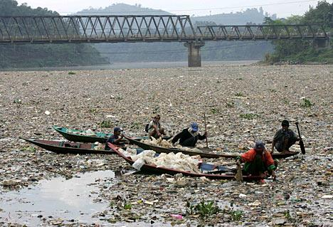
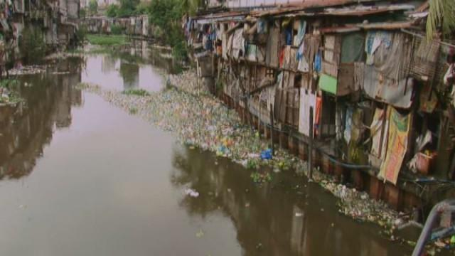
Notes:
The Pasig River - Now

Slide 3
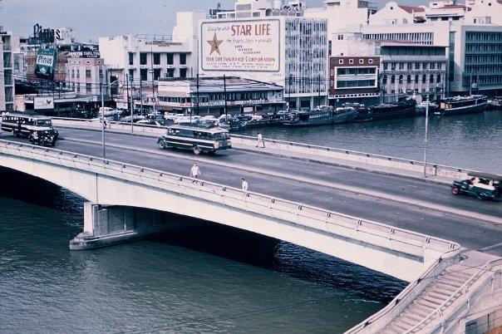
Notes:
The PAsig River - Before; during the 1950’s

Slide 4


Objective
Notes:
Collaborate with ABS-CBN Foundation
- Has a Pasig Clean-up organization (Kapit Bisig Para Sa Ilog Pasig) that do clean up activities
- We are currently in contact with them!

Slide 5
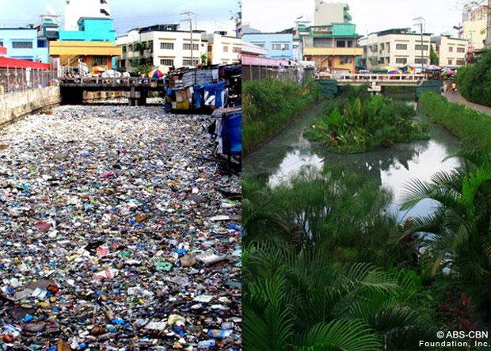

Slide 6
Plans
Clean-Up Times:
  Every 1st Saturday of the month
  For a minimum of 1 year
Logistics:
  Cleaning supplies for volunteers
Expenses:
  Cleaning supplies
  Drinking Water for Individuals
Notes:
For the transportation, we will have students organize carpool.

Slide 7
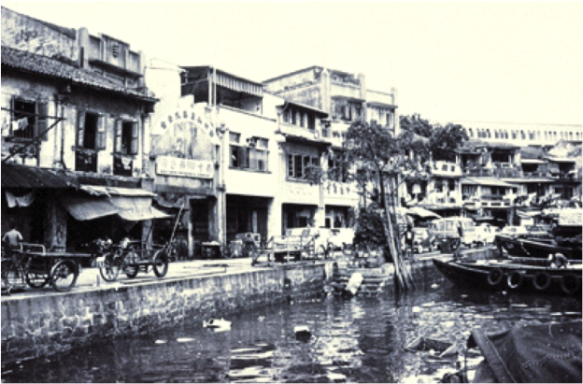
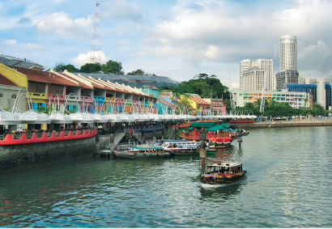
Our Inspiration: Singapore River

Slide 8
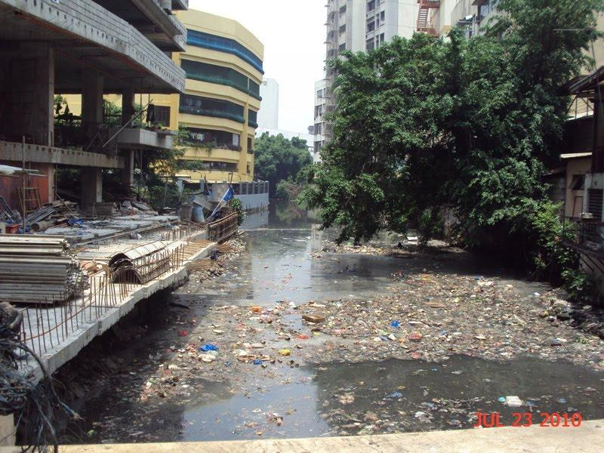

Slide 9
